Slide 1
Analyzing Advertising Impact on Sales: A Data-Driven Approach
Subtitle

Slide 2
Average amount spent on TV advertisements

Slide 3
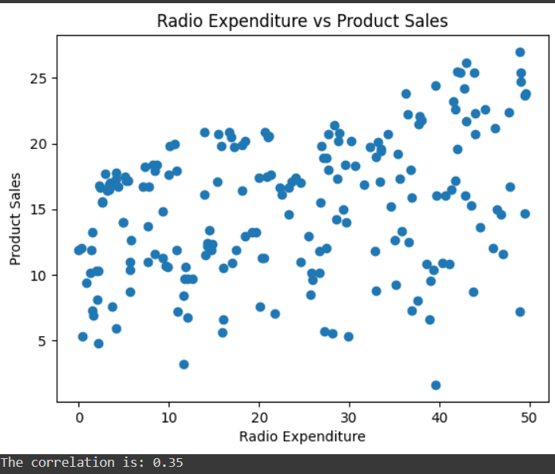
Correlation between radio advertising expenditure and product sales
The scatter plot shows that there is a positive correlation.
This implies that an increase in radio advertising expenditure leads to higher product sales.

Slide 4
Advertising medium with the highest impact on sales
Measuring Correlations: The code checks how closely related the amount spent on each type of advertising (TV, radio, newspaper) is to the product sales.
Finding the strongest correlation: After looking at the strength of these relationships, we identify which one is the strongest.

Slide 5
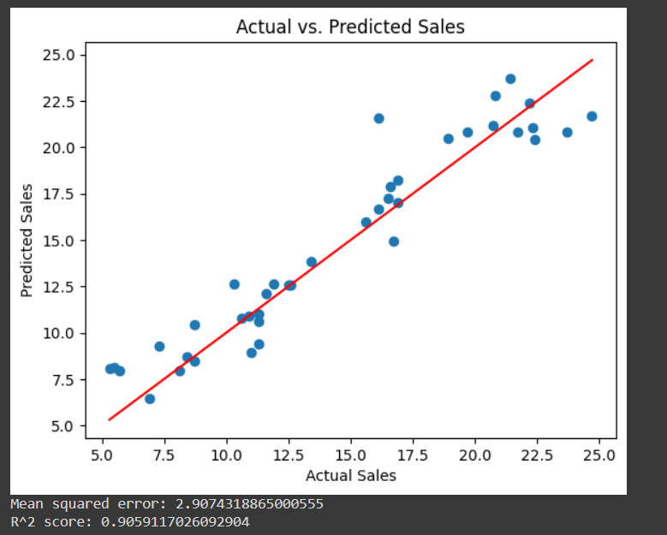
Predicting Sales with a Multi-Variable Linear Regression Model: TV, Radio, and Newspaper
Insights made:
Strong Predictive Power: Predictions closely match actual sales.
High R² Score: ~0.91, indicating 91% of sales variability is explained by the model.
Low Mean Squared Error: ~2.91, reflecting high model accuracy.
Linearity: Data points align well along the red line, showing a linear relationship.

Slide 6

Predicting Sales Based on New Advertising Expenditures
After analysing the data and creating a machine learning model, we predicted the sales
If one spends $200 on TV, $40 on Radio and $50 on Newspapers, the predicted sales is $19.87

Slide 7
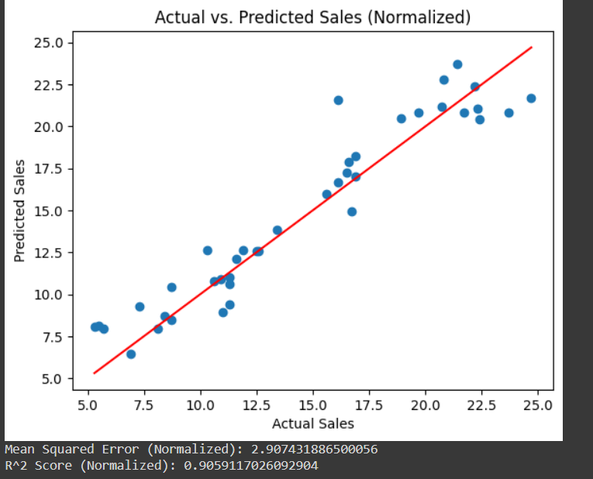
Impact of Normalization on Linear Regression Model Performance
Insights made:​
​
The performance metrics for both the non-normalized and normalized datasets are almost identical.
This indicates that normalization did not have a significant impact on the performance of the linear regression model in this case.
​
​

Slide 8
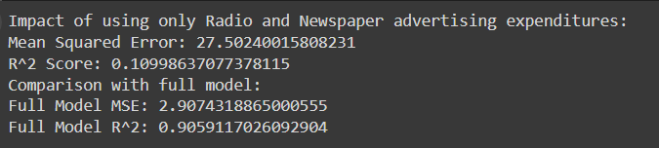
Impact of Using Only Radio and Newspaper Advertising Expenditures on Sales Predictions
Key Insights:
Performance Measurement: The analysis looks at how accurately the model predicts sales using only radio and newspaper advertising compared to the full model.
Results: The predictions using just radio and newspaper advertising were slightly less accurate than those using all three types of advertising (including TV).
Conclusion: This suggests that TV advertising plays an important role in predicting sales. Including TV advertising data makes the predictions more precise.

